Slide 1

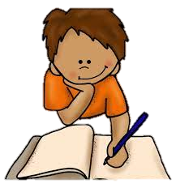


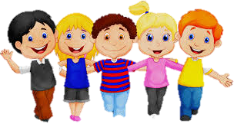
All About Me
Year 7 Health
Lesson 4
2024

Slide 2

Assessment Task 1: All about me
Reminder:
Assessment Task 1 – All About Me
Due: 11:30pm tonight
DUE TODAY
Notes:
Change time to whatever you choose.

Slide 3

Review (Pg. 13).
Week 1 – 3 are now complete!! Well done!
In the first 5 minutes of each lesson you will complete your revision page, you will find these throughout your online booklet.
The revision page consists of three questions. It will need to be completed in detail. One word answers will not be accepted.
The three questions :
What two concepts or ideas did I learn in class last week?
What did I find interesting about last week’s lesson? Provide a specific example.
Any questions or new words you have learnt?
The teacher will go over this each lesson with you to see what you have learnt
Now that you have completed your first two weeks, it is time to revise what you have learnt from class.
You have 5 mins to complete the revision sheet.

Slide 4
Hook: Graffiti wall
In the middle of the board is the word RESILIENCE
Come to the whiteboard and write what you think of when you hear the word resilience.
Write one word and give the marker to someone else. It doesn’t matter if responses are repeated.
You have 2 minutes.
Bounce back
RESILIENCE
Responsible
Notes:
Write RESILIENCE on the whiteboard. Invite students up to the front to add what they think of when they see/hear the word resilience. Discuss responses and identify any common themes.

Slide 5
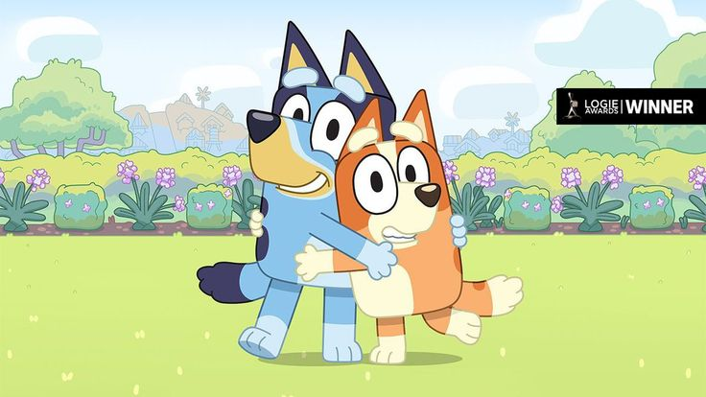
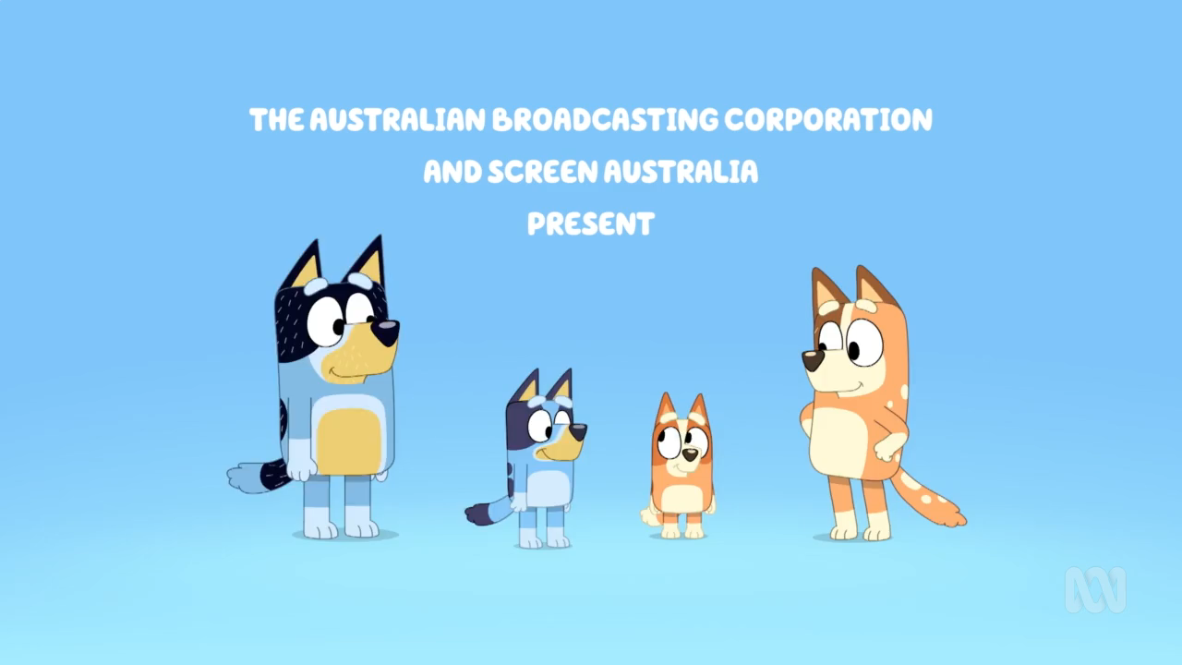
Activity 1: (Pg. 14). Bluey – Resilience
While watching the video,
answer questions on Pg. 14.

Slide 6

Activity 2: Five skills of resilience (Pg. 15).
Notes:
Assessment 2 related
https://www.youtube.com/watch?v=ASDBJXDNqvc

Slide 7


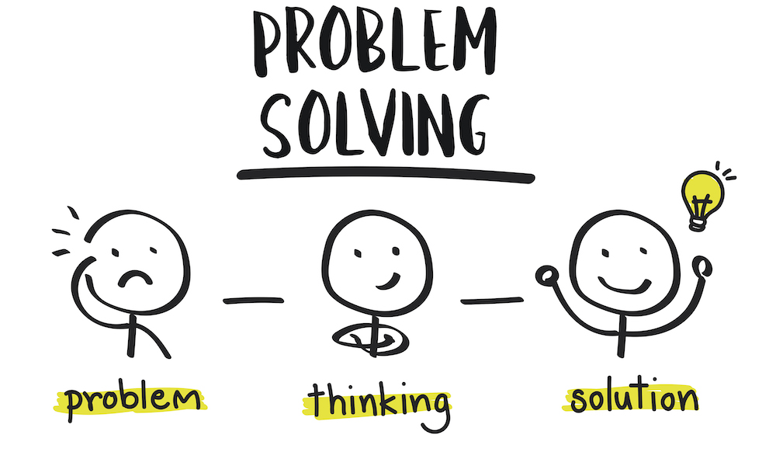


ACTIVITY 2: Five Skills of resilience (Pg. 15).
Understanding Emotions:
The ability to recognize and manage emotions in a healthy and constructive way. This skill involves understanding and accepting your own and others' emotions and employing strategies to regulate emotional responses.
Helpful & Positive Thinking:
Cultivating a positive mindset and optimistic outlook, even in difficult situations. This skill involves reframing challenges as opportunities for growth and maintaining hope. Thinking “what’s wrong with the situation” not “what’s wrong with me.”
Resourcefulness:
Developing effective problem-solving skills and the ability to adapt to changing circumstances. This skill includes identifying problems, generating solutions, and taking action to overcome obstacles.
Relationship Skills:
Developing and maintaining positive relationships with family, friends, mentors, or support networks. This skill involves knowing how and who to talk to when you need help and being able to effectively communicate during challenges or disagreements.
Self-understanding:
Knowing your strengths and limitations, what you value, how to show courage and self-reflection. This skill also includes taking care of one's physical health, managing stress levels, practicing relaxation techniques, and engaging in activities that promote overall well-being.
Notes:
Assessment 2 related
Fill in the blanks

Slide 8

EXIT TICKET:
Each person will receive a sticky note.
Write your answer to the following question:
“TWO WAYS I CAN SHOW RESILIENCE THIS WEEK ARE…”

